Slide 1
Category review: Chips
Jan 2025
Retail Analytics

Slide 2
Notes:
To view Privacy video explaining how important data privacy is to Quantium, please click here: https://www.youtube.com/watch?v=Zq1QDAkoRzU
or here Q:\Company Reference\Brand & Design\Brand videos\Q Privacy.mp4
At Quantium, we believe that data is the behavioural footprint of humanity and that it has to be treated with the utmost care and responsibility.
Histories, attitudes, indeed lives are stored within it in ways that aren’t always apparent – and that’s what makes its potential so powerful.
To work with it responsibly, sensitively, we set ourselves the highest data privacy protection and governance standards.
We have spent 17 years perfecting privacy-by-design and secure-by-design principles. Central to this is not holding any personally identifiable information about people –
we neither receive it, and put the necessary protections in place to be unable to decipher it.
Every aspect of handling data is safeguarded: from its de-identification, to its encryption – data security is paramount and of the highest grade.
We pride ourselves on gaining the trust of iconic organisations around the world through years of securely working with their data,
and in turn the trust that builds with their stakeholders.

Slide 3
Executive summary
01
Task 1
The Mainstream Young Singles/Couples is the best customer segment to target to increase sales.
02
Task 2
Trial stores did not exhibit significantly higher sales compared to control stores during the trial period (February to April). However, a sales surge occurred in March across all trial stores.

Slide 4
01
Category

Slide 5
Daily total sales
The total sales of chips are stable over the period
High sales
Christmas Eve
Low sales
Christmas (no sales)
The total sales ($) is highest on Christmas Eve at $6923
There are two drops in total sales below $4500 (potential seasonality): 2018-08-14 to 2018-08-20 and 2019-05-14 to 2019-05-20
The daily total sale fluctuate around $5311 over the period

Slide 6
Customer segment
Mainstream Young Singles/Couples is the largest customer segment
Mainstream
Premium
Budget
Premium
Mainstream
Budget
3 largest group of customers are Retirees, Older singles/couples and young single/couples by life stage
New Families is the smallest customer segment and most of them are Budget customer
Older singles/couples customer has the highest number of Premium customer
Young singles/couples customer has the highest number of Mainstream customers.

Slide 7
Customer segment
Life stages shape customer spending and product pricing decisions
Premium
Mainstream
Budget
Customer who have a family are mostly budget customers.
Customer who haven’t has a family or retire Mainstream customers.

Slide 8
Total sales by customer segment
Budget Older Families, Mainstream Young Singles/Couples and Retirees are the customer segments with the highest sales
Premium
Mainstream
Budget
*ordered by lowest total sales by life stage to highest
Older Singles/Couples customer segment has the highest total sales by life stage
Budget Older Families has the highest total sales following by Mainstream Young Singles/Couples and Mainstream Retirees

Slide 9
Total units by customer segment
Budget Older Families, Mainstream Retirees and Young Singles/Couples are the customer segments with the highest units sold
Premium
Mainstream
Budget
*ordered by lowest total units by life stage to highest
The observation is very similar to the total sales ($) for the customer segment
Older Singles/Couples customer segment has the highest total units by life stage
Budget Older Families has the highest total sales following by Mainstream Retirees and Mainstream Young Singles/Couples

Slide 10
Target customer segment
Mainstream Young Singles/Couples should be targeted to increase sales
Average sales by customer segment
Mainstream Young Singles/Couples has the second highest average sales over the period
Mainstream Young Singles/Couples customers are willing to pay a higher price for chips
Can capitalize on their purchasing power and preferences, driving higher revenue
Average purchased price by customer segment
Premium
Mainstream
Budget

Slide 11
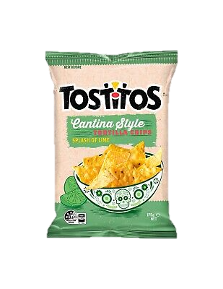
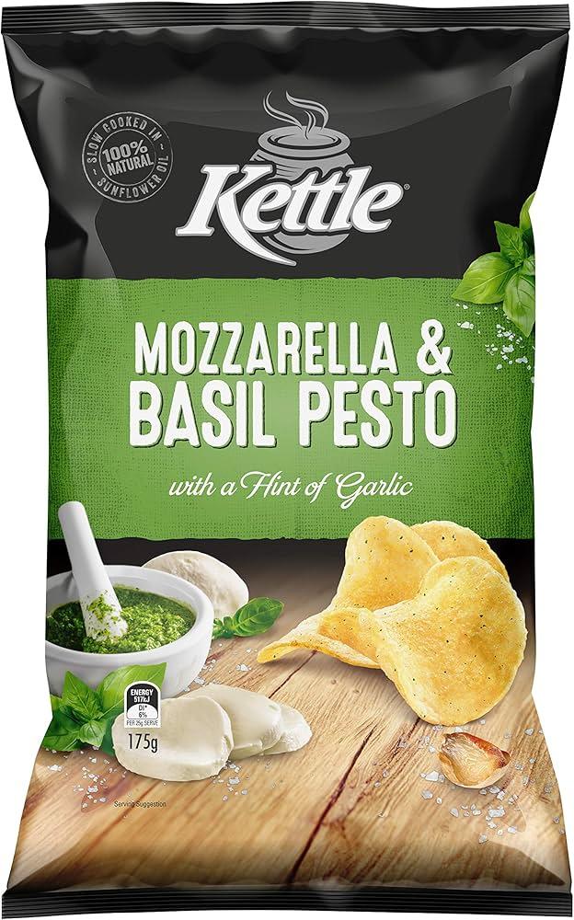
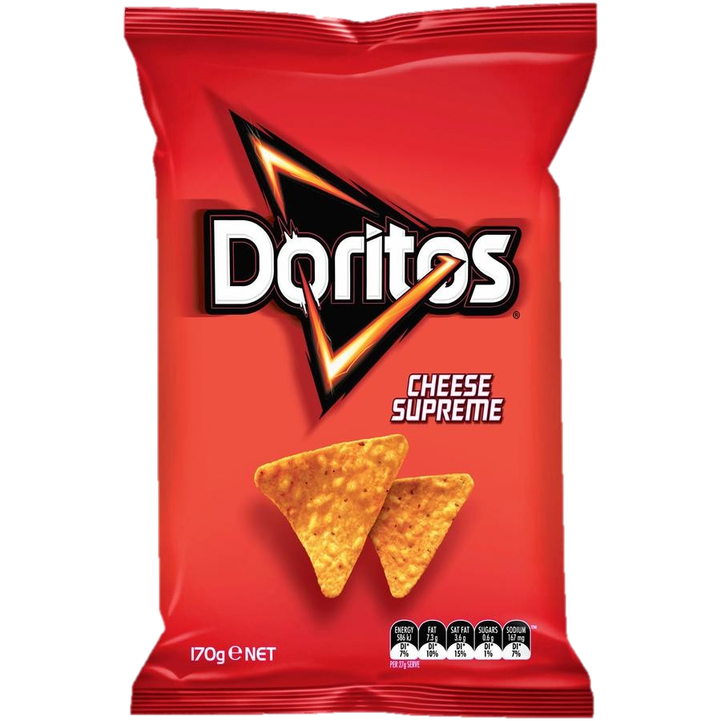
Target customer segment preference
Mainstream Young Singles/Couples prefers premium chips
Top brands by sales
Top 3 products by sales
01
02
03
Kettle Mozzarella Basil & Pesto 175g
Price: $5.40
Doritos Corn Chips Cheese Supreme 170g
Price: $4.40
Tostitos Splash Of Lime 175g
Price: $4.40
Most of the chip sales to Mainstream Young Singles/Couples customers are from Kettle (19%)
The top three chips purchased by Mainstream Young Singles/Couples customers are all priced above $4.40, placing them in the upper 25% of 114 chip products
► Targeting these customers with premium-priced products will capitalise on their preference for quality chips

Slide 12
02
Trial store performance

Slide 13
Trial stores vs. Control stores performance
Overall, all three trial stores did not increase sales significantly
Trial Store 77
Control Store 233
Percentile
Trial store 77’s total sales throughout the trial period was higher than the control stores, however the difference was not significant.
Trial period
Trial Store 86
Control Store 155
Percentile
Trial store 86’s total sales in March was the only month that had significant higher sales than the control store.
Trial period
Trial Store 88
Control Store 237
Percentile
Trial store 88’s total sales was significantly higher than the control store in March and April, however for the whole period, the difference was not significant.
Trial period

Slide 14
Quantity sold and number of customers in trial stores in March
The surge in sales in March is likely due to a one-off increase in the number of customers
Trial Store 77
Trial Store 86
No Customer
Quantity sold
No Customer
Quantity sold
Trial Store 88
No Customer
Quantity sold
The surge in sales in March across all three stores was due to an increase in the number of customers on a specific date, leading to higher quantities sold and increased revenue. However, sales did not sustain throughout the period, suggesting that this was likely a one-time event.
*No customer is equal to quantity sold for store 88

